Slide 1
Variable Page Selection
PrintNet T
Repeating Tables – PrintNet T
April 23, 2008

Slide 2
Agenda
Variable Page Selection
Repeating Tables – PrintNet T
April 23, 2008

Slide 3

1. Variable Page Selection
Repeating Tables – PrintNet T
April 23, 2008

Slide 4

Variable Pages – Purpose
  Set of pages with different content for each customer
Customer 1
Customer 2
Customer 3
Repeating Tables – PrintNet T
April 23, 2008
Notes:
Every customer will have a different number and type of pages in their record. There are a few reasons for this:
Content of the flow area can overflow from one page to another; each customer will have a different number depending on their variable data.
Some of the pages can be skipped (there is no need to print them – no data for exact customer)‏
In this example you can see an Intro page, a Main page, and an End page.
All of them are overflowing or missing. It depends on customer data.

Slide 5







Variable Pages – Example
A credit card company prints variable pages for different customers in the same billing month.
+
=
2 pages total
Customer 1 (student)‏
Ad (1 page)‏
Statement (1 page)‏
+
+
=
5 pages total
Customer 2 (businessman)‏
Ad (1 page)‏
Statement (3 pages)‏
Coupon (1 page)‏
Ad (Layout page 1)‏
Statement (Layout page 2)‏
Coupon (Layout page 3)‏
Repeating Tables – PrintNet T
April 23, 2008
Notes:
In this example, Customer 1 is a student and Customer 2 is a well-paid businessman. Both are customers of the same credit card company, but the student obviously uses his credit card much less than the businessman does.
The credit card company uses PrintNet T to print their monthly bills for their customers:
Layout Page 1: an advertisement (both Customer 1 and Customer 2 receive this).
Layout Page 2: the credit card statement itself; Customer 1 receives only one printed page of this, because he hasn’t used his credit card very much this month; Customer 2 receives three printed pages of this, because he uses his credit card all the time, thus, the table containing his transactions overflows and needs more than one page.
Layout Page 3: a coupon for $1,000 off of the purchase of a new car; Customer 1 doesn’t get this page printed for him, because he is not a Gold Card member; Customer 2 is a Gold Card member, and he has made a large amount of purchases using his credit card – the credit card company wants to reward Customer 2 for his loyalty and patronage, so they present him with a coupon from one of their partner companies (in this case, a car manufacturer).
Variable page selection is needed to print the different pages for each customer using the same PrintNet T job. Customer 1 receives two printed pages, Customer 2 receives 5 printed pages, etc.

Slide 6
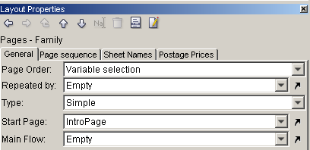
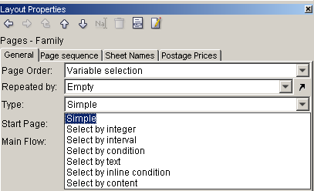
Variable Page Selection
  Variable pages can be set in the Layout Properties of the “Pages” node
  The type of variable selection can be specified (Select by)‏
Repeating Tables – PrintNet T
April 23, 2008
Notes:
Variable Page selection can be specified in a very similar way as the flows can be specified.
Select by:
Integer
Interval
Condition
Text
Inline Condition
Content

Slide 7
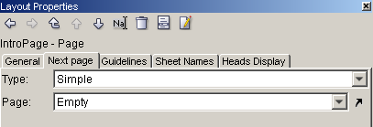
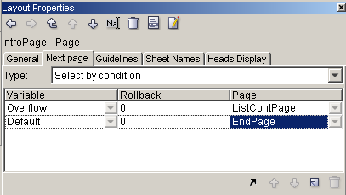
Variable Page Selection
  Next Page Tab
  Type of Condition
  Definition of the condition by variable
Repeating Tables – PrintNet T
April 23, 2008
Notes:
With variable page selection activated, a new menu tab “Next Page” occurs within an individual page’s Layout Properties window.
The page order after each page has to be specified there. This is done using various kinds of conditions (select by…).
The conditions are defined by variables (for example, with the boolean variable “overflow”)‏
By default there is an “else” condition – if the main conditions are not fulfilled, what is the next step?

Slide 8


Variable Pages – Exercise I
Create a simple layout using variable page selection.
  Open VariablePages1.wfd
  Create a list of bike event participants
  Use name and surname variables, and assign a starting number to each biker
  Set up your variable page selection so that the whole list is displayed, followed by the sponsor page.
  Proof the job <F6>
  Set the correct values in Layout Properties, Next Page tabs
  Check your data context
  Define your flow order
Repeating Tables – PrintNet T
April 23, 2008
Notes:
Check VariablePages1_done.wfd for the resolution.
If nobody can figure out the “starting number” tell them to use CustID.

Slide 9
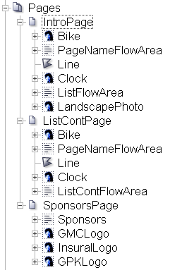
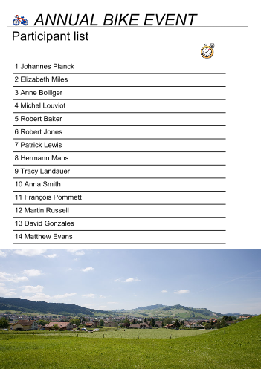
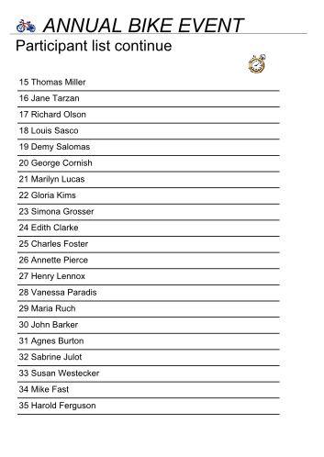
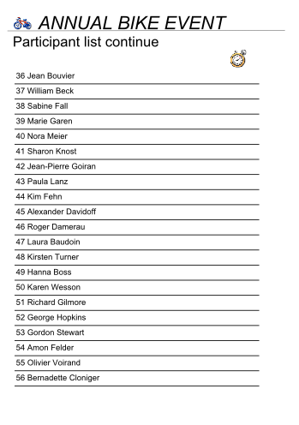
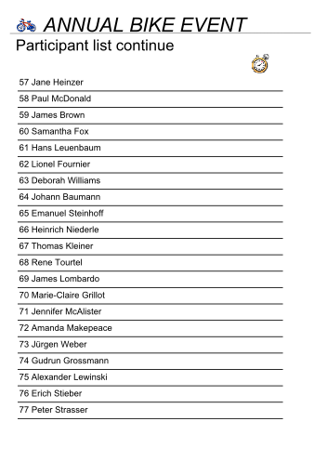
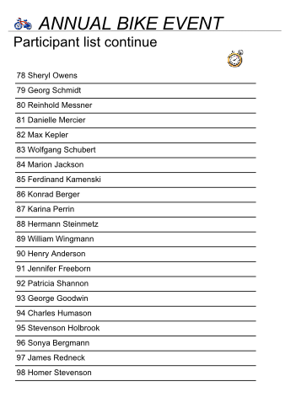


Variable Pages – Exercise I
Repeating Tables – PrintNet T
April 23, 2008
Notes:
VariablePages1_done.wfd
Notice: Data Records By: Empty – ask the trainees why?
Answer: we want to make only list of names (records), not the list for each record

Slide 10
Variable Pages – Exercise II
Create personalized pages in accordance with a customer’s country.
  Open VariablePages2.wfd
  Add texts to pages 2 and 3 based on french_text.txt and german_text.txt
  Set the Layout Properties for the “Pages” node (Page Order, Repeated By, Type, Variable)‏
  Create page selection conditions and use correct values for the page selection
  Proof the job <F6>
  Check the finished job
Repeating Tables – PrintNet T
April 23, 2008
Notes:
Check VariablePages2_done.wfd for resolution.
Encourage trainees to look at the data proof to find out how they will variably select a page (in this case, select by text, and then use the first initial of the country they are from (France, Germany).

Slide 11

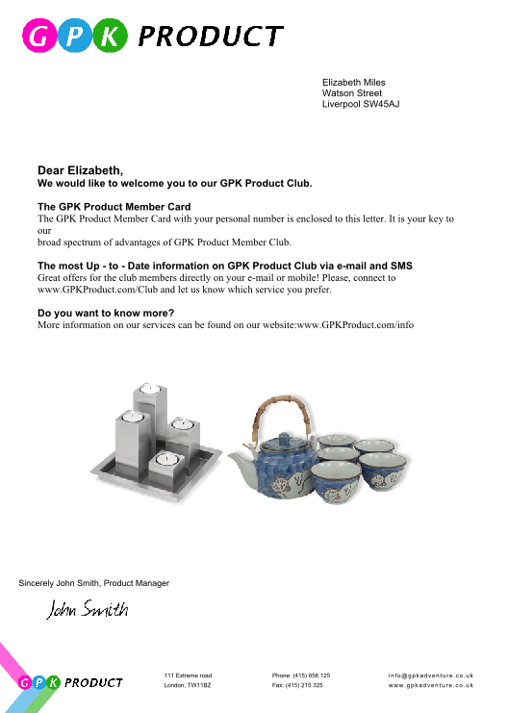

Variable Pages – Exercise II
The document is variable by customer’s country and gender.
Repeating Tables – PrintNet T
April 23, 2008
Notes:
VariablePages2_done.wfd

Slide 12

Variable Pages – Summary
In this part of the presentation we have learned:
  How to:
    Set the page order from simple to variable
    Manage the selection of each page of Layout with the Next page tab
    Add page selection conditions and set correct pages to them
    Set page to overflow from one page to another
    Choose the pages in accordance with the exact condition
Repeating Tables – PrintNet T
April 23, 2008

Slide 13

Variable Pages – Discussion
What types of condition can be used in variable page selection?
How is it possible to change the condition for next page?
What has to be set to enable Next page tab in Layout properties?
What is the purpose of using variable page selection?
Repeating Tables – PrintNet T
April 23, 2008
Notes:
1. What types of condition can be used in variable page selection?
Select by: Integer, Interval, Condition, Text, Inline Condition, Content.
2. How is it possible to change the condition for next page?
Change pages node from simple to variable.
3. What has to be set to enable Next page tab in Layout properties?
Page Order – Variable Selection in “Page” node.
What is the purpose to use variable page selection?
Different set of pages for different customers.

Slide 14

Thank You.
Do You Have Any Questions?
Repeating Tables – PrintNet T
April 23, 2008

